Slide 1
Ch2-2 How to improve cache performance (cont.)

Slide 2
5.3 Cache performance
CPU Execution time=
=(CPU clock cycles + Memory stall cycles)×Clock cycle time
CPI_{Execution} includes ALU and Memory instructions

Slide 3
Average Memory Access Time
Whole accesses time
Average Memory Access Time＝
All memory accesses in program
Accesses time on hitting+ Accesses time on miss
＝
All memory accesses in program
＝ Hit time + (Miss Rate × Miss Penalty)

Slide 4
Cache performance metrics
Miss rate
Independent of the speed of hardware.
Average memory access time (AMAT)
Better than miss rate , but
Indirect measure of performance
CPUtime

Slide 5
Ex1: Impact on Performance
Suppose a processor executes at
Clock Rate = 200 MHz (5 ns per cycle), Ideal (no misses) CPI = 1.1
50% arith/logic, 30% ld/st, 20% control
Suppose that 10% of memory operations get 50 cycle miss penalty
Suppose that 1% of instructions get same miss penalty
Calculate the AMAT and real CPI.
Answer:
AMAT=(1/1.3)x[1.1+0.01x50]+(0.3/1.3)x[1.1+0.1x50]
=2.64
CPI = ideal CPI + average stalls per instruction
= 1.1(cycles/ins) + [ 0.30(DataMops/ins) x 0.10(miss/DataMop) x 50 (cycle/miss)] + 1(InstMop/ins) x 0.01 (miss/InstMop) x 50 (cycle/miss)] = (1.1 + 1.5 + .5) cycle/ins = 3.1
= ideal CPI + (AMAT - HitTime) x AccessOp/ins
= 1.1 + (2.64 – 1.1) x (1 + 0.3) = 3.1
Notes:
Average stalls per instruction = (AMAT – HitTime) x access times/ins

Slide 6
Ex2: Impact on Performance
Assume : Ideal CPI=1 (no misses)
L/S’s structure . 50% of instructions are data accesses
Miss penalty is 25 clock cycles
Miss rate is 2%
How faster would the computer be if all instructions were cache hits?
Answer: first compute the performance for always hits:
CPU_{execution time} =(CPU clock cycles+memory stall cycles)×clock cycle
=(IC ×CPI+0) ×Clock cycle
=IC ×1.0 ×clock cycle

Slide 7
Answer for example 2 (cont.)
Now for the computer with the real cache,first compute memory stall cycles:
The total performance is thus:
CPU execution time cache =(IC ×1.0+IC ×0.75) ×Clock cycle
=1.75 ×IC ×Clock cycle
The performance ratio is the inverse of the execution times
CPU execution time _{cache} 1.75 ×IC ×Clock cycle
CPU execution time 1.0 × IC ×clock cycle
The computer with no cache misses is 1.75 time faster.
＝

Slide 8
Ex3: Impact on Performance
Assume : unified caches: 32K unified cache
Split cache: 16K D-cache and 16K I-cache
36% of the instructions are data transfer instructions
A hit takes 1 colck cycle
The miss penalty is 100 clock cycles
A load/store take 1 extra clock cycle on a unified cache
Write-through with a write-buffer
and ignore stalls due to the write buffer
What is the average memory access time in each case?

Slide 9
MR for Uni.cache & split cache
Miss per 1000 instructions for 2-way associate cache.

Slide 10
Answer for example 3
Answer : first let’s convert misses per 1000 instructions into miss rate.
Misses
/1000 instruction
Miss rate=
Memory accesses/instruction
Since every instruction access has exactly one memory access to fetch the instruction, according as Figure 5.8 the instruction miss rate is
Since 36% of the instructions are data transfers, according as Figure 5.8 the data miss rate is
3.82/1000
Miss rate _{16KB instruction}＝
＝0.0038
1.0
40.9/1000
Miss rate _{16KB data}＝
＝0.1136
0.36

Slide 11
Answer for example 3 (cont.)
Form Figure 5.8 The unified miss rate needs to account for instruction and data accesses:
43.3/1000
Miss rate _{32KB unified}＝
＝0.0318
1.00+0.36
Basing on Figure 2.32 on page 138 there is 74% instruction references in split cache. The average miss rate for the split cache is:
(74%×0.0038)+(26% × 0.1136)=0.0323
Thus ,a 32KB unified cache has a slightly lower effective miss rate than two 16KB caches.

Slide 12
Answer for Example3 (cont.)
The average memory access time can be divided into instruction and data accesses:
Therefore,the time for each organization is
Average memory access time_{split}
=74%×(1+0.0038×100)+ 26%×(1+0.1136×100)
=(74%×1.38)+(26%×12.36)=1.021+3.214=4.25
Average memory access time_{unified}
=74%×(1+0.0318×100)+ 26%×(1+1+0.0318×100)
=(74%×4.18)+(26%×5.18)=3.093+1.347=4.40

Slide 13
Ex4: Impact on Performance
Assume: in-order execution computer, such as the Ultra SPARC Ⅲ.
Miss penalty: 100 clock cycles
Miss rate : 2%
Memory references Per instruction: 1.5
Average cache misses per 1000 instructions: 30
CPI ＝1.0(ignoring memory stalls)
What is the impact on performance when behavior of the cache is included (Calculate the impact using both misses per instruction and miss rate.)?

Slide 14
Answer for example 4
Answer : The performance, including cache misses, is
CPU time _{with cache} ＝
＝IC×(1.0+(30/1000×100)) × Clock cycle time
＝IC × 4.00 × Clock cycle time
Now caculating performance using miss rate:
CPU time _{with cache} ＝
＝IC×(1.0+(1.5×2%×100)) × Clock cycle time
＝IC × 4.00 × Clock cycle time

Slide 15
Answer for example 4 (cont.)
The clock cycles time and instruction count are the same, with or without a cache. Thus, CPU time increases fourfold, with CPI from 1.00 a “perfect cache” to 4.00 with a cache that can miss.
Without any memory hierarchy at all the CPI would increase again to 1.0+100×1.5 or 151—factor of almost 40 time longer than a system with a cache.

Slide 16
Cache misses have a double-barreled impact on a CPU
The lower the CPI_{execution}, the higher the relative impact of a fix number of cache miss clock cycle.
When calculating CPI, the cache miss penalty is measured in CPU clock cycles for a miss. Therefore, even if memory hierarchies for two computers are identical, the CPU with the higher clock rate has a larger number of clock cycles per miss and hence a higher memory portion of CPI.

Slide 17
Ex5: Impact on Performance
Assume: CPI=2 (perfect cache) clock cycle time＝1.0 ns
MPI(memory reference per instruction)＝1.5
Size of both caches is 64K and size of both block is 64 bytes
One cache is direct mapped and other is two-way set associative. the former has miss rate of 1.4%, the latter has miss rate 1.0%
The selection multiplexor forces CPU clock cycle time to be stretched 1.25 times
Miss penalty is 75ns,and hit time is 1 clock cycle
What is the impact of two diffect cache organizations on performance of CPU (first,calculate the average memory access time and then CPU performance.)?

Slide 18
Answer for example 5
Answer : Average memory access time is
Average memory access time＝Hit time+Miss rate×miss penalty
Thus, the time for each organization is
Average memory access time_{1-way}＝1.0+(0.014×75)＝2.05 ns
Average memory access time_{2-way}＝1.0×1.25 +(0.01 ×75)
＝2.00 ns
The average memory access time is better for the 2-way set-associative cache.

Slide 19
Answer for example 5 (cont.)
CPU performance is
Substituting 75 ns for (miss penalty×Clock cycle time), the performance of each cache organization is
CPU time_{1-way}＝IC×(2×1.0+(1.5 ×0.014 ×75))＝3.58 ×IC
CPU time_{2-way}＝IC×(2×1.0×1.25+(1.5 ×0.010 ×75))＝3.63 ×IC

Slide 20
Answer for example 5 (cont.)
Relative performance is
In contrast to the results of average memory access time, the direct-mapped leads to slighly better average performance. Since CPU time is our bottom-line evaluation.

Slide 21
Miss penalty and Out-of-order Execution Processors
How do you define “miss penalty”?
Is it the full latency of the miss to memory, or
is it just the “exposed” or nonoverlapped latency when the processor must stall?
To In-order processor, there is out of question, but here is out of the question.
Refine memory stalls to lead to a new definition of miss penalty as nonoverlapped latency :

Slide 22
Two definition
Length of memory latency –What to consider as the start and the end of a memory operation in an out-of-order processor.
Length of latency overlapped—What is the start of overlap with the processor(or equivalently, when do we say a memory operation is stalling the processor)

Slide 23
Ex6: Performance on out-of-order processor
Assume: 30% of the 75 ns (52.5) miss penalty can be overlapped; Another parameters are same with example 5 (above example)
What is the impact of performance for out-of-order (OOO) CPU in direct-mapped cache?
Answer: Average memory access time for the OOO computer is:
Average memory access time_{1-way,OOO}＝1.0*1.25+(0.014×52.5)
＝1.99 ns
The performance of the OOO cache is:
CPU time_{1-way,OOO}＝IC×(2×1.0 *1.25+ (1.5×0.014×52.5))
＝3.60 ×IC
Hence, despite a much slower clock cycle time and the higher miss rate of a direct-mapped cache, the OOO computer can be slightly faster if it can hide 30% of the miss penalty.
Notes:
OOO的PC reg前要加选择器选择执行哪条指令

Slide 25
How to Improve Cache Performance?
AMAT = HitTime + MissRate×MissPenalty
1. Reduce the time to hit in the cache.--4
——small and simple caches, avoiding address translation, way prediction , and trace caches
2. Increase cache bandwidth .--3
—— pipelined cache access, multibanked caches, non-blocking caches,
3. Reduce the miss penalty--4
——multilevel caches, critical word first, read miss prior to writes, merging write buffers, and victim caches
4. Reduce the miss rate--4
——larger block size, large cache size, higher associativity,and compiler optimizations
5. Reduce the miss penalty and miss rate via parallelism--2
——hardware prefetching,and compiler prefetching

Slide 26
1st Hit Time Reduction Technique: Small and Simple Caches
Using small and Direct-mapped cache
The less hardware that is necessary to implement a cache, the shorter the critical path through the hardware.
Direct-mapped is faster than set associative for both reads and writes.
Fitting the cache on the chip with the CPU is also very important for fast access times.

Slide 27
Hit time varies with size and associativity

Slide 28
2nd Hit Time Reduction Technique: Way Prediction
Way Prediction (Pentium 4 )
Extra bits are kept in the cache to predict the way,or block within set of the next cache access.
If the predictor is correct, the instruction cache latency is 1 clock clock cycle.
If not,it tries the other block, changes the way predictor, and has a latency of 1 extra clock cycles.
Simulation using SPEC95 suggested set prediction accuracy is excess of 85%, so way prediction saves pipeline stage in more than 85% of the instruction fetches.

Slide 29
3rd Hit Time Reduction Technique: Avoiding Address Translation during Indexing of the Cache
Trans-
lation
Main
Memory
VA
PA
miss
Cache
CPU
hit
data
Page table is a large data structure in memory
TWO memory accesses for every load, store, or instruction fetch!!!
Virtually addressed cache?
synonym problem
Cache the address translations?

Slide 30
TLBs
A way to speed up translation is to use a special cache of recently used page table entries -- this has many names, but the most frequently used is Translation Lookaside Buffer or TLB
Virtual Address Physical Address Dirty Ref Valid Access
Really just a cache on the page table mappings
TLB access time comparable to cache access time
(much less than main memory access time)

Slide 31
Translation Look-Aside Buffers
Just like any other cache, the TLB can be organized as fully associative, set associative, or direct mapped
TLBs are usually small, typically not more than 128 - 256 entries even on high end machines. This permits fully associative lookup on these machines. Most mid-range machines use small n-way set associative organizations.
hit
VA
PA
miss
TLB
Lookup
Cache
Main
Memory
CPU
Translation
with a TLB
miss
hit
Trans-
lation
data
1/2 t
t
20 t

Slide 32
Fast hits by Avoiding Address Translation
CPU
CPU
CPU
VA
VA
VA
VA
Tags
$
PA
Tags
$
TB
TB
VA
PA
PA
L2 $
$
TB
MEM
PA
PA
MEM
MEM
Virtual indexed, Physically tagged
Overlap $ access
with VA translation:
requires $ index to
remain invariant
across translation
Conventional
Organization
Virtually Addressed Cache
Translate only on miss
Synonym Problem

Slide 33
Virtual Addressed Cache
Any Problems ?
Send virtual address to cache? Called Virtually Addressed Cache or
just Virtual Cache (vs. Physical Cache)
Every time process is switched logically must flush the cache; otherwise get false hits
Cost is time to flush + “compulsory” misses from empty cache
Add process identifier tag that identifies process as well as address within process: can’t get a hit if wrong process

Slide 34
Virtual cache

Slide 36
Dealing with aliases
Dealing with aliases (synonyms); Two different virtual addresses map to same physical address
NO aliasing! What are the implications?
HW antialiasing: guarantees every cache block has unique address
verify on miss (rather than on every hit)
cache set size <= page size ?
what if it gets larger?
How can SW simplify the problem? (called page coloring)
I/O must interact with cache, so need virtual address

Slide 37
Aliases problem with Virtual cache
If the index and offset bits of two aliases are forced to be
the same, then the aliases address will map to the same block in cache.

Slide 38
Overlap address translation and cache access (Virtual indexed, physically tagged)
Any limitation ?

Slide 39
What’s the limitation?
IF it’s direct map cache, then
Cache size = 2^{index} * 2^{blockoffset} <= 2 ^{pageoffset}
How to solve this problem?
Use higher association. Say it’s a 4 way, then cache size can reach 4 times 2^{pageoffset} with change nothing in index or tag or offset.

Slide 40
Example: Virtual indexed, physically tagged cache
Virtual address wide = 43 bits, Memory physical address wide = 38 bits, Page size = 8KB.
Cache capacity =16KB. If a virtually indexed and physically tagged cache is used.
And the cache is 2-way associative write back cache with 32 byte block size.
index block offset
VA
VPN: 30bits 8bits 5bits
VPN PPN
=
V D 30 bits 25 bits
Cache
=
0
V D 25 bits 256 bits
=
bank0
=
TLB
PPN：25bits
255
=
0
V D 25 bits 256 bits
bank1
255
=

Slide 41
4th Hit Time Reduction Technique: Trace caches
Find a dynamic sequence of instructions including taken branches to load into a cache block.
The block determined by CPU instead of by memory layout.
Complicated address mapping mechanism

Slide 42
Why Trace Cache ?
Bring N instructions per cycle
No I-cache misses
No prediction miss
No packet breaks !
Because branch in each 5 instruction, so cache can only provide a packet in one cycle.

Slide 43
What’s Trace ?
Trace: dynamic instruction sequence
When instructions ( operations ) retire from the pipeline, pack the instruction segments into TRACE, and store them in the TRACE cache, including the branch instructions.
Though branch instruction may go a different target, but most times the next operation sequential will just be the same as the last sequential. ( locality )

Slide 44
Whose propose ?
Peleg Weiser (1994) in Intel corporation
Patel / Patt ( 1996)
Rotenberg / J. Smith (1996)
Paper: ISCA’98

Slide 45
Trace in CPU

Slide 46
Instruction segment

Slide 47
Pentium 4: trace cache, 12 instr./per cycle

Slide 48
How to Improve Cache Performance?
AMAT = HitTime + MissRate×MissPenalty
1. Reduce the time to hit in the cache.--4
——small and simple caches, avoiding address translation, way prediction , and trace caches
2. Increase cache bandwidth .--3
—— pipelined cache access, multibanked caches, non-blocking caches,
3. Reduce the miss penalty--4
——multilevel caches, critical word first, read miss prior to writes, merging write buffers, and victim caches
4. Reduce the miss rate--4
——larger block size, large cache size, higher associativity,and compiler optimizations
5. Reduce the miss penalty and miss rate via parallelism--2
——hardware prefetching,and compiler prefetching

Slide 49
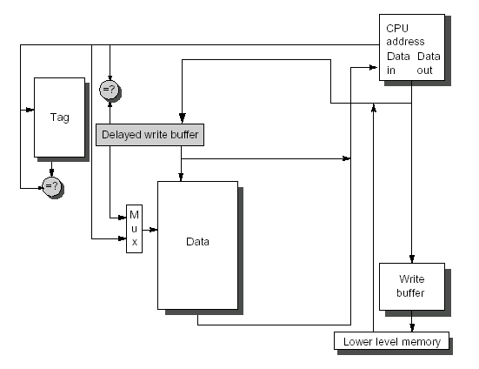
1st Increasing cache bandwidth: Pipelined Caches
What problems for instruction pipeline ?
Hit in multiple cycles,
giving fast clock cycle time

Slide 50
2nd Increasing cache bandwidth: Nonblocking Caches
A nonblocking(Lockup-free cache) cache,allows The cache to continues to supply hits while processing read misses ( hit under miss , hit under multiple miss ).
Complex caches can even have multiple outstanding misses ( miss under miss ). It will further lower effective miss penalty
Nonblocking, in conjunction with out-of-order execution, can allow the CPU to continue executing instructions after a data cache miss.
What’s the precondition ?

Slide 51
Performance of Nonblocking cache

Slide 52
3nd Increasing cache bandwidth: Multibanked Caches
Cache is divided into independent banks that can support simultaneous accesses like interleaved memory banks.
E.g.,T1 (“Niagara”) L2 has 4 banks
Banking works best when accesses naturally spread themselves across banks ⇒ mapping of addresses to banks affects behavior of memory system
Simple mapping that works well is “sequential interleaving”

Slide 53
Single banked two bank two bank two bank
consecutive interleaving group interleaving

Slide 54
Summary: Increase Cache Bandwidth
1. Increase bandwidth via pipelined cache access
2. Increase bandwidth via multibanked caches,
3. Increase bandwidth via non-blocking caches,

Slide 55
How to Improve Cache Performance?
AMAT = HitTime + MissRate×MissPenalty
1. Reduce the time to hit in the cache.--4
——small and simple caches, avoiding address translation, way prediction , and trace caches
2. Increase cache bandwidth .--3
—— pipelined cache access, multibanked caches, non-blocking caches,
3. Reduce the miss penalty--4
——multilevel caches, critical word first, read miss prior to writes, merging write buffers, and victim caches
4. Reduce the miss rate--4
——larger block size, large cache size, higher associativity,and compiler optimizations
5. Reduce the miss penalty and miss rate via parallelism--2
——hardware prefetching, compiler prefetching

Slide 56
1st Miss Penalty Reduction Technique: Multilevel Caches
This method focuses on the interface between the cache and main memory.
Add an second-level cache between main memory and a small, fast first-level cache, to make the cache fast and large.
The smaller first-level cache is fast enough to match the clock cycle time of the fast CPU and to fit on the chip with the CPU, thereby lessening the hits time.
The second-level cache can be large enough to capture many memory accesses that would go to main memory, thereby lessening the effective miss penalty.

Slide 57
Parameter about Multilevel cache
The performance of a two-level cache is calculated in a similar way to the performance for a single level cache.
L2 Equations
AMAT = Hit Time_{L1} + Miss Rate_{L1} x Miss Penalty_{L1}
Miss Penalty_{L1} = Hit Time_{L2} + Miss Rate_{L2} x Miss Penalty_{L2}
AMAT = Hit Time_{L1} +
Miss Rate_{L1} x (Hit Time_{L2} + Miss Rate_{L2} * Miss Penalty_{L2})
So the miss penalty for level 1 is calculated using the hit time, miss rate, and miss penalty for the level 2 cache.

Slide 58
Two conceptions for two-level cache
Definitions:
Local miss rate— misses in this cache divided by the total number of memory accesses to this cache (Miss rate_{L2})
Global miss rate—misses in this cache divided by the total number of memory accesses generated by the CPU
Using the terms above, the global miss for the first-level cache is stall just Miss rate_{L1}, but for the second-level cache it is :

Slide 59
2nd Miss Penalty Reduction Technique: Critical Word First and Early Restart
Don’t wait for full block to be loaded before restarting CPU
Critical Word First—Request the missed word first from memory and send it to the CPU as soon as it arrives; let the CPU continue execution while filling the rest of the words in the block. Also called wrapped fetch and requested word first
Early restart—As soon as the requested word of the block arrives, send it to the CPU and let the CPU continue execution
Generally useful only in large blocks,
Spatial locality => tend to want next sequential word, so not clear if benefit by early restart

Slide 60
Example: Critical Word First
Assume:
cache block＝64-byte
L2: take 11 CLK to get the critical 8 bytes,(AMD Athlon)
and then 2 CLK per 8 byte to fetch the rest of the
block
There will be no other accesses to rest of the block
Calculate the average miss penalty for critical word first.
Then assuming the following instructions read data sequentially 8 bytes at a time from the rest of the block
Compare the times with and without critical word first.

Slide 61
3rd Miss Penalty Reduction Technique: Giving Priority to Read Misses over Writes
If a system has a write buffer, writes can be delayed to come after reads.
The system must, however, be careful to check the write buffer to see if the value being read is about to be written.

Slide 62
Write buffer
Write-back want buffer to hold displaced blocks
Read miss replacing dirty block
Normal: Write dirty block to memory, and then do the read
Instead copy the dirty block to a write buffer, then do the read, and then do the write
CPU stall less since restarts as soon as do read
Write-through want write buffers => RAW conflicts with main memory reads on cache misses
If simply wait for write buffer to empty, might increase read miss penalty (old MIPS 1000 by 50% )
Check write buffer contents before read; if no conflicts, let the memory access continue

Slide 63
4th Miss Penalty Reduction Technique: Merging write Buffer
One word writes replaces with multiword writes, and it improves buffers’s efficiency.
In write-through ,When write misses if the buffer contains other modified blocks,the addresses can be checked to see if the address of this new data matches the address of a valid write buffer entry.If so,the new data are combined with that entry.
The optimization also reduces stalls due to the write buffer being full.

Slide 64
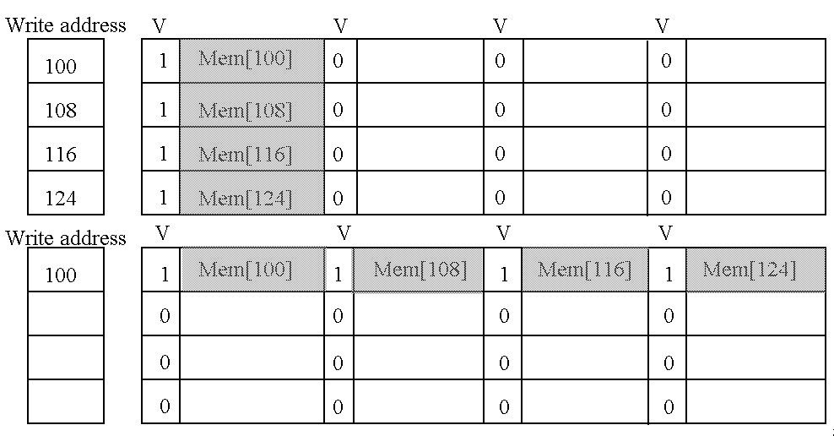
Write merging

Slide 65
Miss Penalty Reduction Technique: Victim Caches
A victim cache is a small (usually, but not necessarily) fully-associative cache that holds a few of the most recently replaced blocks or victims from the main cache.
This cache is checked on a miss data before going to next lower-level memory(main memory).
to see if they have the desired item
If found, the victim block and the cache block are swapped.
The AMD Athlon has a victim caches (write buffer for write back blocks ) with 8 entries.

Slide 66
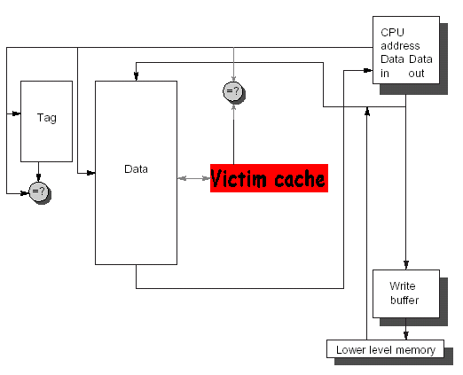
The Victim Cache

Slide 67
How to combine victim Cache ?
How to combine fast hit time of direct mapped yet still avoid conflict misses?
Add buffer to place data discarded from cache
Jouppi [1990]: 4-entry victim cache removed 20% to 95% of conflicts for a 4 KB direct mapped data cache
Used in Alpha, HP machines
TAGS
DATA
Tag and Comparator
One Cache line of Data
Tag and Comparator
One Cache line of Data
Tag and Comparator
One Cache line of Data
Tag and Comparator
One Cache line of Data
To Next Lower Level In
Hierarchy

Slide 68
Summary: Miss Penalty Reduction
1. Reduce penalty via Multilevel Caches
2. Reduce penalty via Critical Word First
3. Reduce penalty via Read Misses over Writes
4. Reducing penalty via Merging write Buffer

Slide 70
How to Improve Cache Performance?
AMAT = HitTime + MissRate×MissPenalty
1. Reduce the time to hit in the cache.--4
——small and simple caches, avoiding address translation, way prediction , and trace caches
2. Increase cache bandwidth .--3
—— pipelined cache access, multibanked caches, non-blocking caches,
3. Reduce the miss penalty--4
——multilevel caches, critical word first, read miss prior to writes, merging write buffers, and victim caches
4. Reduce the miss rate--4
——larger block size, large cache size, higher associativity,and compiler optimizations
5. Reduce the miss penalty and miss rate via parallelism--2
——hardware prefetching,and compiler prefetching

Slide 71
Where misses come from?
Classifying Misses: 3 Cs
Compulsory—The first access to a block is not in the cache, so the block must be brought into the cache. Also called cold start misses or first reference misses. (Misses in even an Infinite Cache)
Capacity—If the cache cannot contain all the blocks needed during execution of a program, capacity misses will occur due to blocks being discarded and later retrieved. (Misses in Fully Associative Size X Cache)
Conflict—If block-placement strategy is set associative or direct mapped, conflict misses (in addition to compulsory & capacity misses) will occur because a block can be discarded and later retrieved if too many blocks map to its set. Also called collision misses or interference misses. (Misses in N-way Associative, Size X Cache)
4th “C”:
Coherence - Misses caused by cache coherence.
Notes:
Intuitive Model by Mark Hill

Slide 72
3Cs Absolute Miss Rate (SPEC92)

Slide 73
3Cs Relative Miss Rate
Flaws: for fixed block size
Good: insight => invention

Slide 74
Reducing Cache Miss Rate
To reduce cache miss rate, we have to eliminate some of the misses due to the three C's.
We cannot reduce capacity misses much except by making the cache larger.
We can, however, reduce the conflict misses and compulsory misses in several ways:

Slide 75
Cache Organization?
Assume total cache size not changed:
What happens if:
Change Block Size:
Change Associativity:
3) Change Compiler:
Which of 3Cs is obviously affected?
Notes:
Ask which affected?
Block size
1) Compulsory
2) More subtle, will change mapping

Slide 76
1st Miss Rate Reduction Technique: Larger Block Size (fixed size&assoc)
Larger blocks decrease the compulsory miss rate by taking advantage of spatial locality.
Drawback--curve is U-shaped
However, they may increase the miss penalty by requiring more data to be fetched per miss.
In addition, they will almost certainly increase conflict misses since fewer blocks can be stored in the cache.
And maybe even capacity misses in small caches
Trade-off
Trying to minimize both the miss rate and the miss penalty.
The selection of block size depends on both the latency and bandwidth of lower-level memory

Slide 77
Miss Rate relates Block size
Block size | Cache size
 | 4K | 16K | 64K | 256K
16 | 8.57% | 3.94% | 2.04% | 1.09%
32 | 7.24% | 2.87% | 1.35% | 0.70%
64 | 7.00% | 2.64% | 1.06% | 0.51%
128 | 7.78% | 2.77% | 1.02% | 0.49%
256 | 9.51% | 3.29% | 1.15% | 0.49%

Slide 78
Performance curve is U-shaped
Reduced
compulsory
misses
Increased
Conflict
Misses
What else drives up block size?

Slide 79
Example: Larger Block Size (C-26)
Assume: memory takes 80 clock cycles of overhead and then delivers 16 bytes every 2 cycles.
1 clock cycle hit time independent of block size.
Which block size has the smallest AMAT for each size in Fig.5.17 ?
Answer:
AMAT_{16-byte block, 4KB} = 1+(8.57%*82)=8.027
AMAT_{256-byte block}, _{256KB}= 1+(0.49%*112)=1.549

Slide 80
2nd Miss Rate Reduction Technique: Larger Caches
Cache Size
rule of thumb: 2 x size => 25% cut in miss rate
What does it reduce ?

Slide 81
Pro. Vs. cons for large caches
Pro.
Reduce capacity misses
Con.
Longer hit time, Higher cost, AMAT curve is U-shaped
Popular in off-chip caches
Block size | Miss penalty | Cache size
 |  | 4K | 16K | 64K | 256K
16 | 82 | 8.027 | 4.231 | 2.673 | 1.894
32 | 84 | 7.082 | 3.411 | 2.134 | 1.588
64 | 88 | 7.160 | 3.323 | 1.933 | 1.449
128 | 96 | 8.469 | 3.659 | 1.979 | 1.470
256 | 112 | 11.651 | 4.685 | 2.288 | 1.549

Slide 82
3rd Miss Rate Reduction Technique: Higher Associativity
Conflict misses can be a problem for caches with low associativity (especially direct-mapped).
With higher associativity decreasing Conflict misses to improve miss rate
cache rule of thumb
2:1 rule of thumb a direct-mapped cache of size N has the same miss rate as a 2-way set-associative cache of size N/2.
Eight-way set associative is for practical purposes as effective in reducing misses for these sized cache as fully associative.

Slide 83
Associativity
2:1 rule of thumb
Conflict

Slide 84
Associativity vs Cycle Time
Beware: Execution time is only final measure!
Why is cycle time tied to hit time?
Will Clock Cycle time increase?
Hill [1988] suggested hit time for 2-way vs. 1-way external cache +10%, internal + 2%
suggested big and dumb caches

Slide 85
Avg. Memory Access Time vs. Miss Rate (P430)
Example: assume CCT = 1.36 for 2-way, 1.44 for 4-way, 1.52 for 8-way vs. CCT direct mapped
Cache Size Associativity
(KB) 1-way 2-way 4-way 8-way
4 3.44 3.25 3.22 3.28
8 2.69 2.58 2.55 2.62
16 2.33 2.40 2.46 2.53
32 2.06 2.30 2.37 2.45
64 1.92 2.24 2.18 2.25
128 1.52 1.84 1.92 2.00
256 1.32 1.66 1.74 1.82
512 1.20 1.55 1.59 1.66
(Red means A.M.A.T. not improved by more associativity)

Slide 86
4th Miss Rate Reduction Technique: Way Prediction and Pseudo-Associative Cache
Using two Technique reduces conflict misses and yet maintains hit speed of direct-mapped cache
Predictive bit - Pseudo-Associative
Way Prediction (Alpha 21264 )
Extra bits are kept in the cache to predict the way,or block within set of the next cache access.
If the predictor is correct, the instruction cache latency is 1 clock clock cycle.
If not,it tries the other block, changes the way predictor, and has a latency of 3 clock cycles.
Simulation using SPEC95 suggested set prediction accuracy is excess of 85%, so way prediction saves pipeline stage in more than 85% of the instruction fetches.

Slide 87
Pseudo-Associative Cache (column associative)
How to combine fast hit time of Direct Mapped and have the lower conflict misses of 2-way SA cache?
Divide cache: on a miss, check other half of cache to see if there, if so have a pseudo-hit (slow hit)
Drawback: CPU pipeline is hard if hit takes 1 or 2 cycles
Better for caches not tied directly to processor (L2)
Used in MIPS R1000 L2 cache, similar in UltraSPARC
Hit Time
Pseudo Hit Time
Miss Penalty
Time

Slide 88
Pseudo-Associative Cache

Slide 89
4th Miss Rate Reduction Technique: Compiler Optimizations
The techniques reduces miss rates without any hardware changes and reorders instruction sequence with compiler.
Instructions
Reorder procedures in memory so as to reduce conflict misses
Profiling to look at conflicts(using tools they developed)
Data
Merging Arrays: improve spatial locality by single array of compound elements vs. 2 arrays
Loop Interchange: change nesting of loops to access data in order stored in memory
Loop Fusion: Combine 2 independent loops that have same looping and some variables overlap
Blocking: Improve temporal locality by accessing “blocks” of data repeatedly vs. going down whole columns or rows

Slide 90
Merging Arrays
Combining independent matrices into a single compound array.
Improving spatial locality
Example
/*before*/
Int val[SIZE];
Int key[SIZE];
/*after*/
Struct merge{
int val;
int key;
}
Struct merge merged_array[SIZE]

Slide 91
b. Loop Interchange
By switching the order in which loops execute, misses can be reduced due to improvements in spatial locality.
/* Before */
for (k = 0; k < 100; k = k+1)
for (j = 0; j < 100; j = j+1)
for (i = 0; i < 5000; i = i+1)
x[i][j] = 2 * x[i][j];
/* After */
for (k = 0; k < 100; k = k+1)
for (i = 0; i < 5000; i = i+1)
for (j = 0; j < 100; j = j+1)
x[i][j] = 2 * x[i][j];
Sequential accesses instead of striding through memory every 100 words;

Slide 92
c. Loop fusion
By fusion the code into a single loop, the data that are fetched into the cache can be used repeatedly before being swapped out.
Imporving the temporal locality
Example:
/*before*/ /*after*/
For (i=0; i<N; i=i+1) For (i=0; i<N; i=i+1)
For (i=0; j<N; j=i+1) For (j=0; j<N; j=i+1)
a[i][j]=1/b[i][j]*c[i][j]; {
For (i=0; i<N; i=i+1)
a[i][j]=1/b[i][j]*c[i][j];
For (j=0; j<N; j=j+1) d[i][j]=a[i][j]*c[i][j];
d[i][j]=a[i][j]*c[i][j]; }

Slide 93
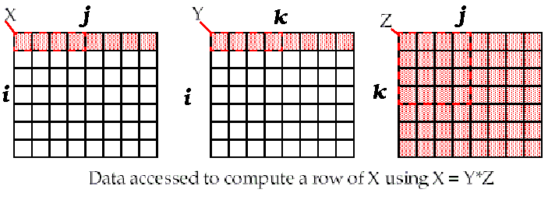
d. Unoptimized Matrix Multiplication
/* Before */
for (i = 0; i < N; i = i+1)
for (j = 0; j < N; j = j+1)
{r = 0;
for (k = 0; k < N; k = k+1)
r = r + y[i][k]*z[k][j];
x[i][j] = r;
};
Two Inner Loops:
Write N elements of 1 row of X[ ]
Read N elements of 1 row of Y[ ] repeatedly
Read all NxN elements of Z[ ]
Capacity Misses a function of N & Cache Size:
2N³ + N² => (assuming no conflict; otherwise …)
Idea: compute on BxB submatrix that fits
x[1][j]
y[1][k]
z[k][j]
((N+N)N+N)N=2N³ + N²
Accessed For N³ operations

Slide 94
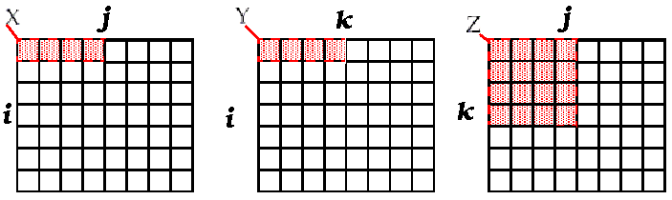
Blocking optimized Matrix Multiplication
Matrix multiplication is
performed by multiplying the
submatrices first.
/* After */
for (jj = 0; jj < N; jj = jj+B)
for (kk = 0; kk < N; kk = kk+B)
for (i = 0; i < N; i = i+1)
for (j = jj; j < min(jj+B-1,N); j = j+1)
{r = 0;
for (k = kk; k < min(kk+B-1,N); k = k+1)
r = r + y[i][k]*z[k][j];
x[i][j] = x[i][j] + r;
};
Y benefits from spatial locality
Z benefits from temporal locality
Capacity Misses from 2N³ + N² to N³/B+2N²
BN
BN
B×B
B called Blocking Factor
(BN+BN)+B²)×(N/B)²=2N³/B + N²
Accessed For N³ operations

Slide 95
Reducing Conflict Misses by Blocking
Conflict misses in caches not FA vs. Blocking size
Lam et al [1991] a blocking factor of 24 had a fifth the misses vs. 48 despite both fit in cache

Slide 96
Summary of Compiler Optimizations to Reduce Cache Misses (by hand)

Slide 97
Summary: Miss Rate Reduction
3 Cs: Compulsory, Capacity, Conflict
1. Larger cache
2. Reduce Misses via Larger Block Size
3. Reduce Misses via Higher Associativity
4. Reducing Misses by Compiler Optimizations
5. Pseudo associative cache

Slide 98
How to Improve Cache Performance?
AMAT = HitTime + MissRate×MissPenalty
1. Reduce the time to hit in the cache.--4
——small and simple caches, avoiding address translation, way prediction , and trace caches
2. Increase cache bandwidth .--3
—— pipelined cache access, multibanked caches, non-blocking caches,
3. Reduce the miss penalty--4
——multilevel caches, critical word first, read miss prior to writes, merging write buffers, and victim caches
4. Reduce the miss rate--4
——larger block size, large cache size, higher associativity,and compiler optimizations
5. Reduce the miss penalty and miss rate via parallelism--2
——hardware prefetching,and compiler prefetching

Slide 99
1st Miss Penalty/Rate Reduction Technique: Hardware Prefetching of Inst.and data
The act of getting data from memory before it is actually needed by the CPU.
This reduces compulsory misses by retrieving the data before it is requested.
Of course, this may increase other misses by removing useful blocks from the cache.
Thus, many caches hold prefetched blocks in a special buffer until they are actually needed.
E.g., Instruction Prefetching
Alpha 21064 fetches 2 blocks on a miss
Extra block placed in “stream buffer”
On miss check stream buffer
Prefetching relies on having extra memory bandwidth that can be used without penalty

Slide 100
2nd Miss Penalty/Rate Reduction Technique: Compiler-controlled prefetch
The compiler inserts prefetch instructions to request the data before they are needed
Data Prefetch Load data into register (HP PA-RISC loads)
Cache Prefetch: load into cache (MIPS IV, PowerPC, SPARC v. 9)
Special prefetching instructions cannot cause faults; a form of speculative execution
Prefetching comes in two flavors:
Binding prefetch: Requests load directly into register.
Must be correct address and register!
Non-Binding prefetch: Load into cache.
Can be incorrect. Faults?
Issuing Prefetch Instructions takes time
Is cost of prefetch issues < savings in reduced misses?
Higher superscalar reduces difficulty of issue bandwidth

Slide 101
Example (P307): Compiler-controlled prefetch
for( i=0; i <3; i = i +1)
for( j=0; j<100; j=j+1)
a[i][j] = b[j][0] * b[j+1][0];
16B/block， 8B/element， 2elements/block
A[i][j]: 3*100 the even value of j will miss,
the odd values will hit, total 150 misses
B[i][j]：101*3 the same elements are accessed for each iteration of i
j=0 B[0][0]、B[1][0] 2
j=1 B[1][0]、B[2][0] 1
total 2+99=101 misses

Slide 102
Example cont.: Compiler-controlled prefetch
For (j=0; j<100; j=j+1){
Prefetch(b[j+7][0]);
prefetch(a[0][j+7]);
a[0][j]=b[j][0]*b [j+1][0];}; 7 misses for b
4 misses for a
For (I=1; I<3; I=I+1)
For (j=0; j<100; j=j+1){
prefetch(a[i][j+7]);
a[i][j]=b[j][0]*b [j+1][0];};4 misses for a[1][j]
4 misses for a[2][j]
Total: 19 misses
save 232 cache misses at the price of 400 prefetch instructions.

Slide 103
End.

